Slide 1
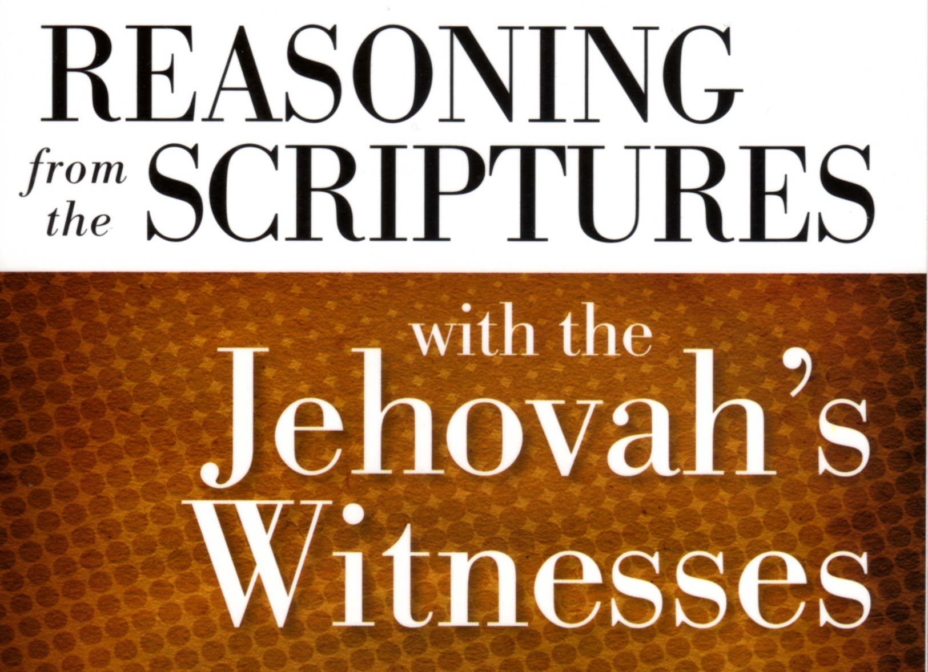

Slide 2
Colossians 1:16-17
NWT (New World Translation):
By means of him all [other] things were created in the heavens and upon the earth, the things visible and the things invisible, no matter whether they are thrones or lordships or governments or authorities. All [other] things have been created through him and for him. Also, he is before all [other] things and by means of him all [other] things were made to exist.
ESV:
For by him all things were created, in heaven and on earth, visible and invisible, whether thrones or dominions or rulers or authorities—all things were created through him and for him. And he is before all things, and in him all things hold together.

Slide 3
Luke 13:2
ESV:
Do you think that these Galileans were worse sinners than all the other Galileans, because they suffered in this way?”

Slide 4
John 1:1
NWT:
In the beginning the Word was, and the Word was with God, and the Word was a god.
ESV:
In the beginning was the Word, and the Word was with God, and the Word was God.

Slide 5
Colossians 2:9
NWT:
It is in him that all the fullness of the divine quality dwells bodily.
ESV:
For in him the whole fullness of deity dwells bodily.

Slide 6
Zechariah 12:10
NWT:
And I will pour out upon the house of David and upon the inhabitants of Jerusalem the spirit of favor and entreaties, and they will certainly look to the One whom they pierced through, and they will certainly wail over Him as in the wailing over an only [son]; and there will be a bitter lamentation over him as when there is bitter lamentation of the firstborn [son].
ESV:
And I will pour out on the house of David and the inhabitants of Jerusalem a spirit of grace and pleas for mercy, so that, when they look on me, on him whom they have pierced, they shall mourn for him, as one mourns for an only child, and weep bitterly over him, as one weeps over a firstborn.

